Slide 1
Review Ammonia Pipe Markers
Copyright ER Playbook. May be used and distributed by public agencies for non-commercial use with attribution to the ER Playbook

Slide 2
Learning Objective and References
Learning Objective
Given a photograph, or actual ammonia refrigeration pipe marker, and access to a job aid or internet reference, the responder shall identify all of the following:
Product in the pipe
Pipe use or purpose based on the abbreviation section
Physical state of the ammonia in the pipe
Estimated pressure range in the pipe (more or less than 70 psi)
Direction the product flows
References:
The Emergency Response Playbook page for Ammonia Refrigeration System Pipe Colors and Markings which may be used as a job-aid for this training by public agencies for non-commercial use.

Slide 3
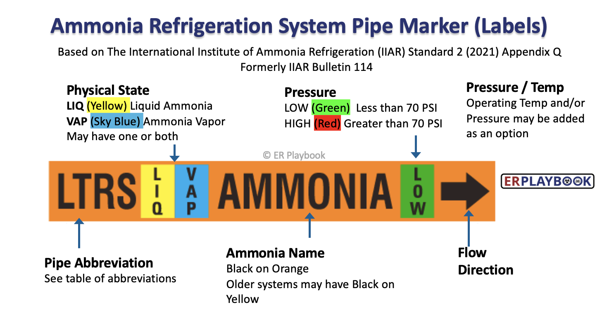
Photo copyright ER Playbook. May be used and distributed by public agencies for non-commercial use.
Ammonia pipe markers will contain five sections of information including:
Abbreviation Section: Printed in black on an a safety orange background
Physical State Section: Either LIQ with a yellow background for liquid ammonia or VAP for with a sky blue background for vapor phase ammonia.
Marker Body: Body color to be Safety Orange and contain the refrigerant "AMMONIA" printed in black
Pressure Level Section: Either LOW with a green background for less than 70psi or HIGH with a red background for greater than 70 psi.
Directional Arrow: Arrow printed in black showing the direction the product flows.

Slide 4
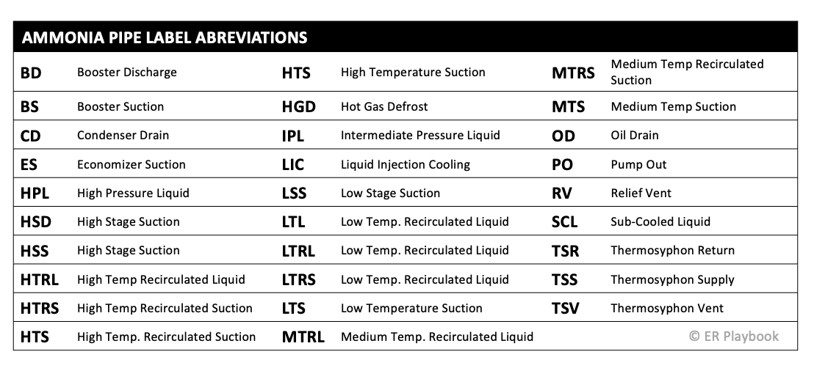
Ammonia Pipe Label Abbreviations
Photo copyright ER Playbook. May be used and distributed by public agencies for non-commercial use.

Slide 5

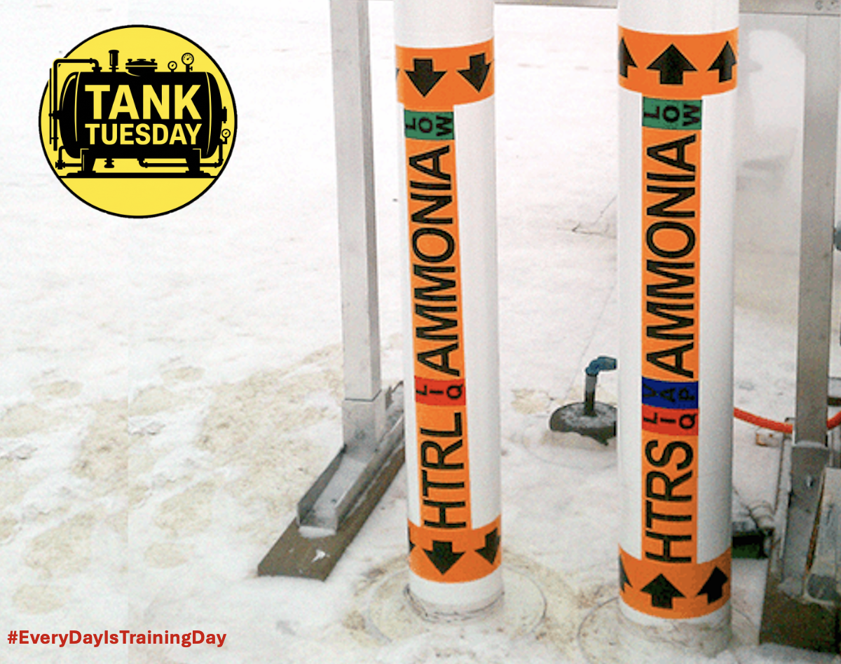
Quiz
Photo copyright ER Playbook. May be used and distributed by public agencies for non-commercial use.
When responding to an incident with an ammonia refrigeration system. Your assigned to recon the roof when you notice a small leak coming from the pipe on the left. What information can you gather about the leaking pipe from the pipe marker?

Slide 6


